Slide 1
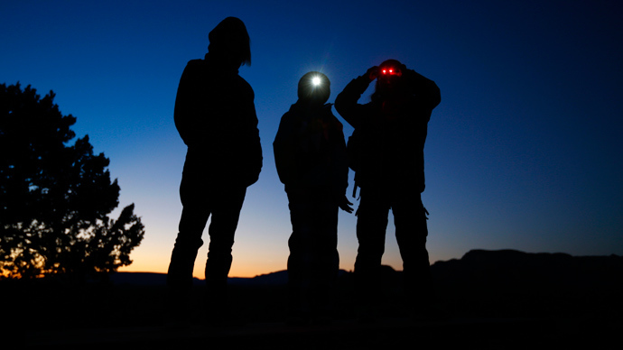
OPERATION COWBOY

Slide 2
1. BACKGROUND
You are part of an elite team called “P Force” who are all anti- cyber / anti terrorist specialists
You are so covert that even the British Government and Mi5 / Mi6 are unaware of your existence
You report to the Chief…he pays your wages and that is all you know!

Slide 3
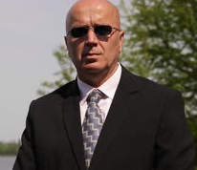
2. TEAM MEMBERS
The Chief
You- Cyber Security Specialist
Zane- Anti Terrorist Specialist
Suzie- Weapons Specialist

Slide 4

3. OPERATION BRIEFING
What can you find out about Area 51 in the USA? e.g. Google Maps, information on the internet, images of "Extra Terrestrial" activity This is operation is codenamed:
OPERATION COWBOY. Go!

Slide 5
4. TASK 1- WHAT SATELLITE
IMAGES ARE THERE?
Add screenshot of route

Slide 6
5. TASK 2- WHAT IS AREA 51? WHY IS IT SO SECRET?
Now summarise what you found out on the internet

Slide 7
6. TASK 3- FIND IMAGES OF EXTRA TERRESTRIAL ACTIVITY AT AREA 51?
Screenshot here

Slide 8
YOU HAVE COMPLETED ANOTHER MISSION
Great investigation on this very secure US Military site. This will be useful for future investigations.
Good work,
The Chief

