Slide 1
How Does 2019 Film Joker Represent People, Place, Issues and Events
https://www.youtube.com/watch?v=t433PEQGErc&safe=active
Based on the Genre of Action/Adventure and sub genre of Comic books how should this trailer represent the following:
Men- strong, action based, driven, clear ideas or…
Women- weaker, stereotypes, non heroic
Place- a crime ridden, criminal based environment, big city
Issues- are there issues mainly of desperation or repression or fairness of people
Events- significant events have happened
NOW LETS LOOK AT THE TRAILER
  What do we think now!

Slide 2
Representation
-----------------------
B1: Genre, narrative, representation and audience interpretation.

Slide 3

Audience vs Representation
Preferred reading – the audience responds to the product the way media producers want/expect them to without questioning – these are passive audiences.
Negotiated reading – the audience knows what the producer wants it to think and knows why that might be an untruthful representation, but forms an opinion which is a combination of both its own perspective and that of the producers. – these are active audiences.
Oppositional reading – the audience completely rejects the product’s message.

Slide 4
How Media Products Represent People
MEN
Representations of men have changed over the past two decades with the emergence of the 'new man' or 'metrosexual', a man in touch with his feminine side and interested in romance, fashion, health and fitness.
​However, the main focus is still on the traditional idea of masculinity which is strong, heroic, with the ability to outsmart life's problems and survive against all odds.
​This kind of masculine representation is seen in action-adventure characters such as James Bond or Indiana Jones.
Sometimes this heroic representation of masculinity is challenged in action-adventures. In Skyfall, we see an ageing James Bond, a more vulnerable hero. This is a more realistic representation of masculinity and age.

Slide 5
How Media Products Represent People
WOMEN
Representations of women in the media have developed and changed with time to reflect the cultural and sociological changes in society. However, female stereotypes continue to appear in some media texts.
​Representations of women are often defined by how men see women (termed the 'male gaze'), or by how society expects women to look and behave.
Many representations of women concentrate on sexuality and emotions.
Others focus on their relationships with their children or romantic partners.

Slide 6
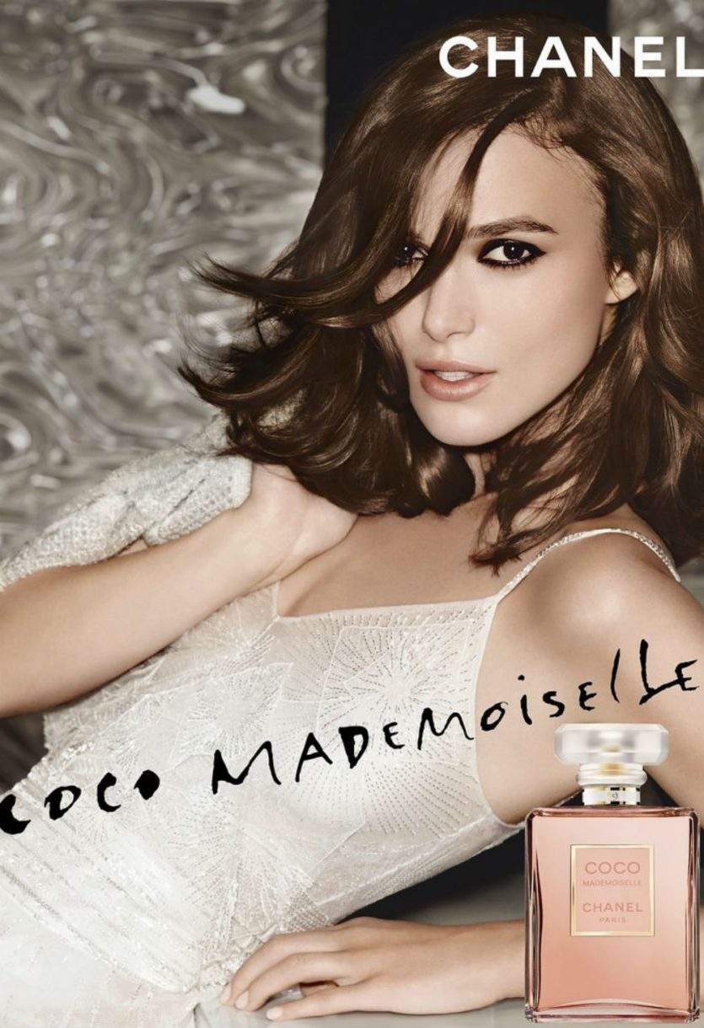
Laura Mulvey’s Male Gaze Theory
The male gaze leads to Hegemonic ideologies within our society.
Hegemonic = ruling or dominant in a political or social context.
Mulvey argues, for women the result of media being represented from the perspective of men. Through the male gaze, women find themselves taking on the male gaze. Women then gaze at other women in the same way as a man would and therefore objectifying other women

Slide 7
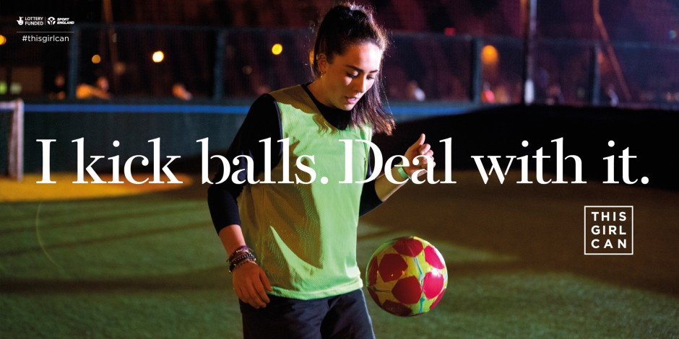
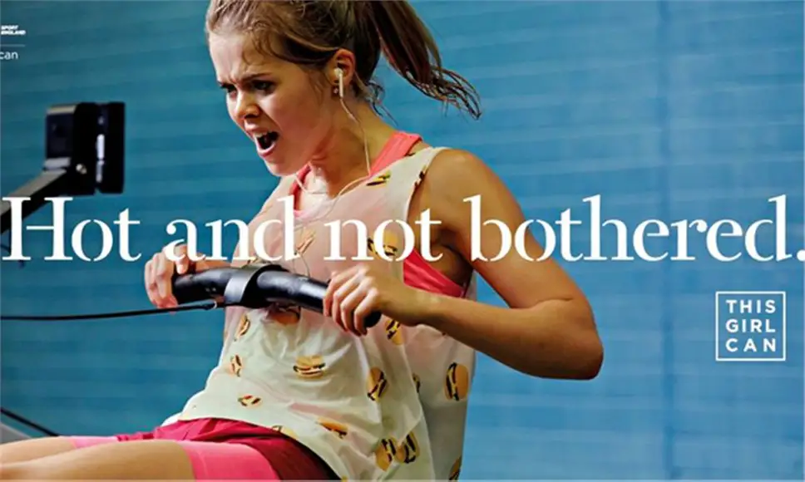
TASK: How are women stereotypically represented in the media?
How are these images different to the usual representations of women?
Stretch and challenge: Consider stereotypical and counter typical portrayals of women.

Slide 8
How Media Products Represent People
YOUNG
Young people are often represented negatively in media texts, which can cause controversy and stimulate debate. Positive representations of young people in the media are much less frequent because positive representations are not as dramatic or entertaining.
​The main media texts which offer positive representation of young people are usually situations which allow them to represent themselves, within a specific context. For instance, auditions on talent shows such as Britain's Got Talent and The X Factor or celebrations of their good deeds on charity programmes like Children in Need.

Slide 9
HOW DO I WRITE ABOUT REPRESENATION OF PEOPLE?
Are the media portraying "the people" them in a positive or negative way? Is it stereotypical or not? Does it relate to the genre?
Are the media portraying young males or adult males in a positive or negative way? Is it stereotypical or not? Does it relate to the genre?
Are the media portraying young females or adult females in a positve or negative way? Is it stereotypical or not? Does it relate to the genre?
Are the media portraying minorities / religions / differing sexual orientations in a positive or negative way? Is it stereotypical or not? Does it relate to the genre?
What are the characters portrayed like? What about people with mise en scene?

Slide 10
How Media Products Represent Places
Events like war, accidents, terrorist attacks, political or celebrity scandals, sporting occasions or criminal trials can all be represented by different media texts in different ways.
​When analysing how an event is represented, it is important to think about how the representation has been constructed and what might affect it.
Always consider:
The ideology of the media text: different newspapers have different ideologies or editorial stances that might affect how an event is portrayed. This can be particularly noticeable in political events like elections when some newspapers support certain parties.#
Codes and Conventions: The mode of address, technical, visual and audio codes, as well as any images used will all affect the representation of an event. The same photo with a different caption can create a very different representation of the same event.
Mediation:The representation will have been constructed with certain information selected by the media producer. In a gossip magazine there might be an article about a celebrity not looking their best however the context of the photos selected might not be mentioned - they may have been at the gym or be unwell, which would explain why they don’t look perfect. Often the information that has been left out can be as important as what has been included.
The target Audience: Who the media text is aimed at will affect how certain events are represented. For instance, a quality newspaper and tabloid newspaper will represent the immigration debate in very different ways.
Many people follow events as they unfold on social media. This could be checking for breaking news updates if there has been an accident or terrorist attack, or following a celebrity scandal as it unfolds.
​
Like other representations, social media can sometimes only show one side or opinion of an event. For instance, if you were to follow an election on social media but only looked at posts from one person you would get a very narrow representation of that election.

Slide 11
How Media Products Represent Issues
Issues are important subjects or topics that people discuss and debate. Issues can include things like education, poverty or body image and can often be controversial - like immigration, LGBT rights or climate change. Media representations of controversial issues can be very influential especially if they are the only opinion on a certain subject that a person reads or hears.
​Poverty is an issue that is highlighted by the rise in the use of food banks
The way the media represents body image often comes in for criticism.
Fashion magazines and some TV programmes tend to represent beauty narrowly - as white, thin and without any imperfections This is an unrealistic representation and can create pressure for young people to conform to an image that may have been created by technological manipulation. Adverts featuring beauty and anti-ageing products are often regarded as unrealistic representations. There have been some challenges to these types of advertising: complaints to the ASA led to two adverts from Lancôme and Maybelline featuring celebrities, Julia Roberts and Christy Turlington, being banned. These adverts were deemed to represent an unrealistic portrayal of the effectiveness of the beauty products and for making unrealistic claims about their products. As a result of this case many advertisements must declare if the image has been digitally altered in post-production, or if implants, hair extensions and other cosmetic enhancements have been used.

Slide 12
How Media Products Represent Events
Events like war, accidents, terrorist attacks, political or celebrity scandals, sporting occasions or criminal trials can all be represented by different media texts in different ways.
​When analysing how an event is represented, it is important to think about how the representation has been constructed and what might affect it.
Always consider:
The ideology of the media text: different newspapers have different ideologies or editorial stances that might affect how an event is portrayed. This can be particularly noticeable in political events like elections when some newspapers support certain parties.#
Codes and Conventions: The mode of address, technical, visual and audio codes, as well as any images used will all affect the representation of an event. The same photo with a different caption can create a very different representation of the same event.
Mediation:The representation will have been constructed with certain information selected by the media producer. In a gossip magazine there might be an article about a celebrity not looking their best however the context of the photos selected might not be mentioned - they may have been at the gym or be unwell, which would explain why they don’t look perfect. Often the information that has been left out can be as important as what has been included.
The target Audience: Who the media text is aimed at will affect how certain events are represented. For instance, a quality newspaper and tabloid newspaper will represent the immigration debate in very different ways.
Many people follow events as they unfold on social media. This could be checking for breaking news updates if there has been an accident or terrorist attack, or following a celebrity scandal as it unfolds.
​Like other representations, social media can sometimes only show one side or opinion of an event. For instance, if you were to follow an election on social media but only looked at posts from one person you would get a very narrow representation of that election.

